Slide 1


Wind Energy Feasibility Dashboard
BY
KALAIVANI J
RAJALAKSHMI INSTITUTE OF TECHNOLOGY
Great! Here's a custom prompt you can copy-paste into Gamma AI to generate a presentation on your project:
✅ Gamma AI Prompt for PPT Generation
Prompt:
Create a professional and engaging presentation titled "Wind Energy Feasibility Dashboard".
This project aims to assess wind energy potential in a given location using real-time and historical wind data. The dashboard integrates Python-based forecasting models and Tableau visualizations.
The presentation should include the following slides:
Title Slide – Project name, author, internship name (Green Interns), and date.
Introduction – Brief about renewable energy importance and the scope of wind energy.
Project Objective – Explain the goal of developing a dashboard to evaluate wind energy feasibility.
Tools & Tech Stack – Python, Windpowerlib, OpenWeather API, Tableau.
SWOT Analysis – Summarize internal strengths & weaknesses and external opportunities & threats.
Data Sources – Mention sources like OpenWeather, NREL, and public CSV datasets.
Dashboard Features – Forecasting, user inputs (location), charts (wind speed trends, feasibility score).
User Impact & Use Cases – Rural communities, NGOs, green startups, policymakers.
Feedback Summary – Include feedback from fellow Green Interns with 3–5 positive statements.
Conclusion & Future Scope – Talk about expanding to solar energy or combined dashboards.
Call to Action – Invite viewers to try the dashboard, contribute data, or collaborate.
Make it clean, minimal, and visually aligned with sustainability themes (green/blue palette). Add icons and charts where relevant. Keep the tone friendly, informative, and impactful.
🟢 Once you paste this into Gamma.app, it will generate a complete deck for you in just a few seconds.
Let me know if you want a shorter or more technical version of the prompt!

Slide 2

The Power of the Wind
Renewable energy is crucial for a sustainable future. Wind energy, in particular, offers immense potential to meet our growing energy demands with minimal environmental impact. This presentation explores a project dedicated to harnessing this power more effectively.

Slide 3




Project Objective: A Clear Vision
Our primary goal is to develop an interactive dashboard that comprehensively evaluates wind energy feasibility for any given location. This tool will empower stakeholders with data-driven insights to make informed decisions about wind energy projects.
Real-time Data Integration
Forecasting Capabilities
User-Friendly Interface
Utilize live wind data for immediate analysis.
Predict future wind patterns for long-term planning.
Ensure accessibility for diverse users.

Slide 4





Tools & Tech Stack: Building Blocks
This dashboard is built on a robust foundation of cutting-edge technologies, ensuring accuracy, efficiency, and powerful visualization.
Python
Windpowerlib
For data processing and forecasting models.
Specialized library for wind energy calculations.
OpenWeather API
Tableau
To fetch real-time and historical wind data.
For interactive and insightful data visualization.

Slide 5

SWOT Analysis: A Balanced View
Strengths
Weaknesses
Accurate forecasting models.
Reliance on API availability.
User-friendly interface.
Initial data processing time.
Integration of diverse data sources.
Requires internet connectivity.
Opportunities
Threats
Growing demand for renewable energy solutions.
Data quality variability.
Potential for global application.
Rapid technological advancements by competitors.
Collaboration with energy companies.
Policy changes affecting renewables.

Slide 6
Key Data Sources: Fueling Insights
Our dashboard leverages a variety of reliable data sources to provide the most accurate and comprehensive wind energy assessments.
OpenWeather API
1
For up-to-date real-time and historical weather data, including wind speed and direction.
NREL (National Renewable Energy Laboratory)
2
Provides extensive meteorological and energy resource data sets crucial for long-term analysis.
Public CSV Datasets
3
Various open-source datasets contribute to a richer and more diverse data foundation.

Slide 7




Dashboard Features: At a Glance
The Wind Energy Feasibility Dashboard is designed with practical functionality at its core, offering intuitive tools for detailed analysis.
Forecasting Models
Location Input
Predictive analytics for future wind patterns and energy output.
Users can specify any location to generate tailored assessments.
Dynamic Charts
Feasibility Score
Visualizations of wind speed trends, energy production, and feasibility scores.
A comprehensive metric indicating the viability of a wind project at a given site.

Slide 8
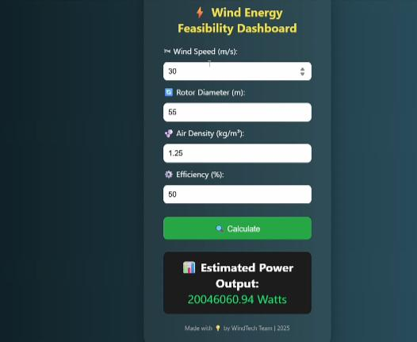

Slide 9
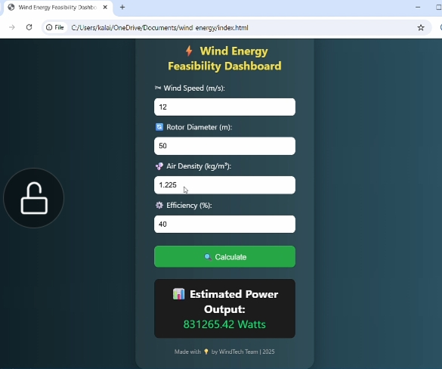

Slide 10
User Impact & Use Cases: Powering Progress
This dashboard holds the potential to significantly impact various sectors, accelerating the adoption of wind energy.
Rural Communities
NGOs
Empowering off-grid electrification and energy independence.
Supporting sustainable development projects in remote areas.
Green Startups
Policymakers
Providing critical data for business planning and investment attraction.
Informing strategic decisions for renewable energy infrastructure and incentives.

Slide 11
Feedback Summary: Insights from Peers
Valuable feedback from fellow Green Interns has been instrumental in refining and improving the dashboard.
"The forecasting accuracy is truly impressive, offering a clear view of long-term potential."
"The user interface is intuitive and easy to navigate, even for non-technical users."
"The integration of multiple data sources provides a robust and credible analysis."
"This dashboard has the potential to be a game-changer for small-scale wind projects."
"The visual representations make complex data understandable at a glance."

Slide 12
Conclusion & Future Scope
The Wind Energy Feasibility Dashboard is a significant step towards data-driven renewable energy solutions. Our journey doesn't end here; the future holds even greater possibilities.
Conclusion
Future Scope
Successfully developed a robust wind energy assessment tool.
Expand to include solar energy feasibility, creating a combined renewable energy dashboard.
Provides actionable insights for diverse stakeholders.
Integrate advanced machine learning algorithms for enhanced forecasting accuracy.
Demonstrates the power of data in renewable energy planning.
Develop a mobile application for on-the-go assessments.
Incorporate economic modeling for ROI analysis of projects.

Slide 13
https://THANKYOUThankyou/drive/folders/1hWOk8IxkXamUNMOavzgb_qBMlXnnJ7eb

